Slide 1

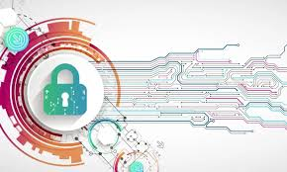
Cybersecurity in the Age of Digital Transformation
Presented By
Mahammad Fardeen Baig

Slide 2
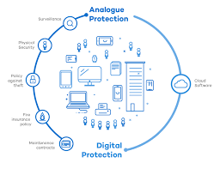
Overview of Digital Transformation and Cybersecurity Digital Transformation: Integration of digital technology into all areas of a business, resulting in fundamental changes in operations and value delivery. Key Components: AI and Machine Learning: Intelligent automation and data insights. Big Data: Advanced analytics for better decision-making. Blockchain: Secure and transparent transactions. Benefits: Increased efficiency and productivity. Enhanced customer experiences. Greater innovation and agility. Improved data-driven decision-making.

Slide 3
Cybersecurity Challenges in Digital Transformation
Increased Attack Surface
Adoption of IoT, mobile devices, and cloud services increases vulnerabilities.
Complexity of Systems
Interconnected systems are harder to secure and monitor.
Human Factor
Human error and insider threats remain significant risks.
Evolving Threat Landscape
Cyber threats are becoming more sophisticated and targeted.
Regulatory Compliance
Ensuring compliance with various cybersecurity regulations is challenging

Slide 4
Key Cybersecurity Strategies Risk Assessment Conduct regular risk assessments to identify and evaluate vulnerabilities within the organization. Zero Trust Model Implement a zero-trust architecture where every access request is verified, regardless of whether it originates inside or outside the network. Multi-Factor Authentication (MFA) Use MFA to add an extra layer of security beyond just passwords, ensuring that only authorized users gain access. Advanced Threat Detection Utilize AI and machine learning to proactively detect and respond to threats. Employee Training and Awareness Conduct regular cybersecurity training and awareness programs to educate employees about potential threats and best practices.

Slide 5
Future Trends in Cybersecurity
Artificial Intelligence and Machine Learning
Predict, detect, and respond to threats in real-time
Zero Trust Architecture
Enforce strict access controls and continuous verification.
Quantum Computing
Quantum computing will impact encryption and cryptography
Cloud Security
Enhanced measures for protecting data in the cloud.

Slide 6
Conclusion and Q&A
Summary of Key Points:
Digital Transformation: Integration of digital technology into all business areas.
Cybersecurity Challenges: Increased attack surface, complexity of systems, human factor, evolving
threats, and regulatory compliance.
Future Trends: AI and machine learning, zero trust architecture, quantum computing, cloud security, IoT security, biometric security, and regulatory compliance.
Cybersecurity Strategies: Risk assessment, zero trust model, multi-factor authentication, advanced threat detection, employee training, and regular software updates.
Final Thoughts:
Proactive cybersecurity measures are essential.
Continuous adaptation and vigilance are necessary.

Slide 7

Thank You
Fardeen Baig

